Slide 1


We want to feel good,
stay fit and be healthy

Slide 2



1850
1960
2020
1:1
3:1
15:1
25:1?
4:1
DNA formation
Science recommends
The turning point
Increasing every decade (EU)
    REFERENCES
    • PUBMED
We used to eat food
from mother nature
But we are not healthy
Chronic disease are on the rice
Full of vitamins, minerals, phyto- and micro nutrients, beta glucans,
fibers, healthy fats and a good balance of Omega-6 and Omega-3.
Hypertension (high blood pressure)
High cholesterol
Arthritis (joints)
Inflammatory Bowel Disease
Crohn's disease

Slide 3
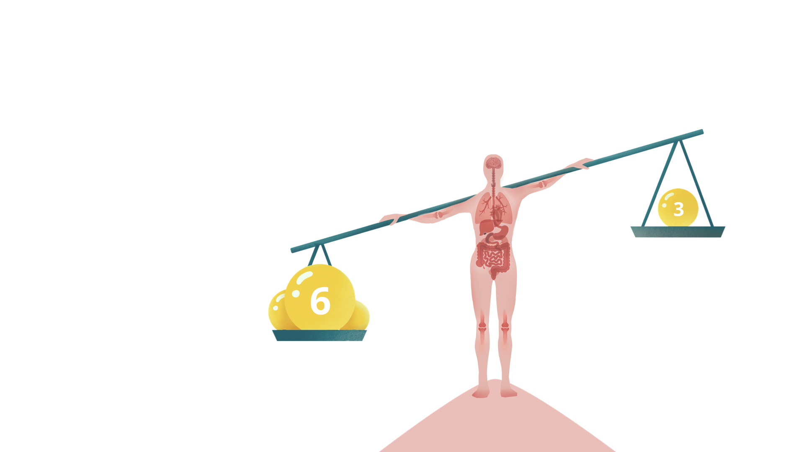
In conclusion:
we lack key nutrients
and have an imbalance
of Omega-6 to Omega-3
Reduced brain function
Hair quality decreases
Reduced heart function
Skin loses elasticity
Organ function is reduced
Joint and muscle pain

Slide 4

Omega 6 and 3 -What is it all about?
Hormones
When we eat
    Leptin
    Insulin
    Glucagon
Inflammation
    Prostaglandin
    Leukotriene
    Resolvins
    Protectins

Slide 5
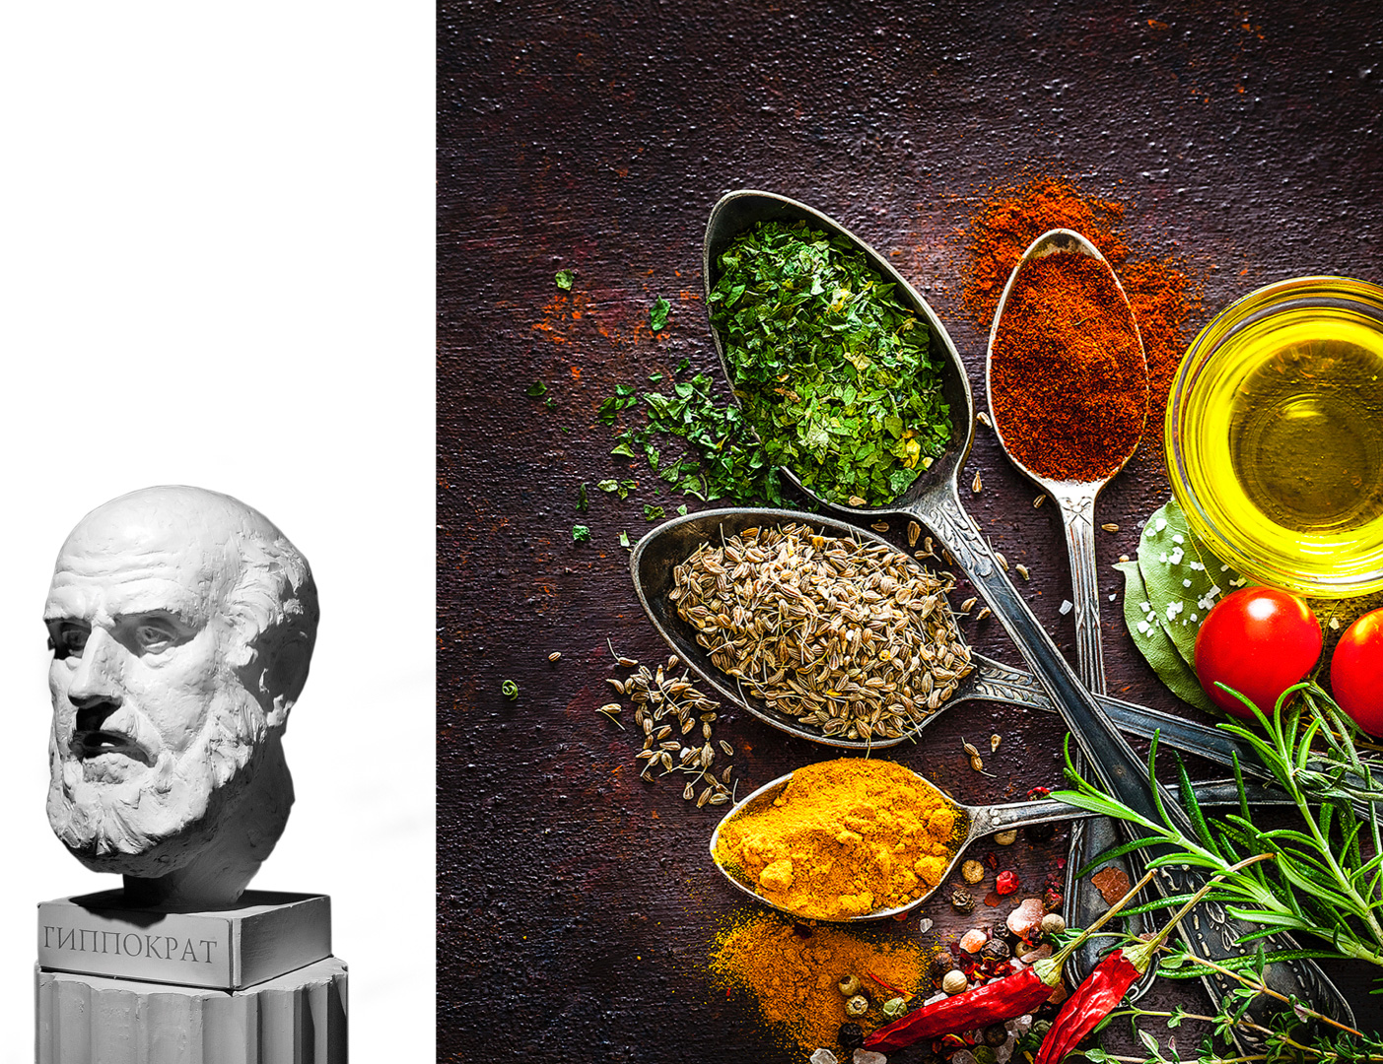
Let your food
be your medicine
and your medicine
be your food
- Hippocrates
460-370 BC

Slide 6
The history of Omega-6 to Omega-3 Balance
Today we eat
man-made food
1850
1:1
3:1
1960
15:1
2020
25:1?
Lower nutrition density, high in sugar, many empty calories,
low in fibers, less healthy fats, and with an imbalance between Omega-6 and Omega-3.
4:1
DNA formation
Science recommends
The turning point
Increasing every decade (EU)
    REFERENCES
    • PUBMED

Slide 7
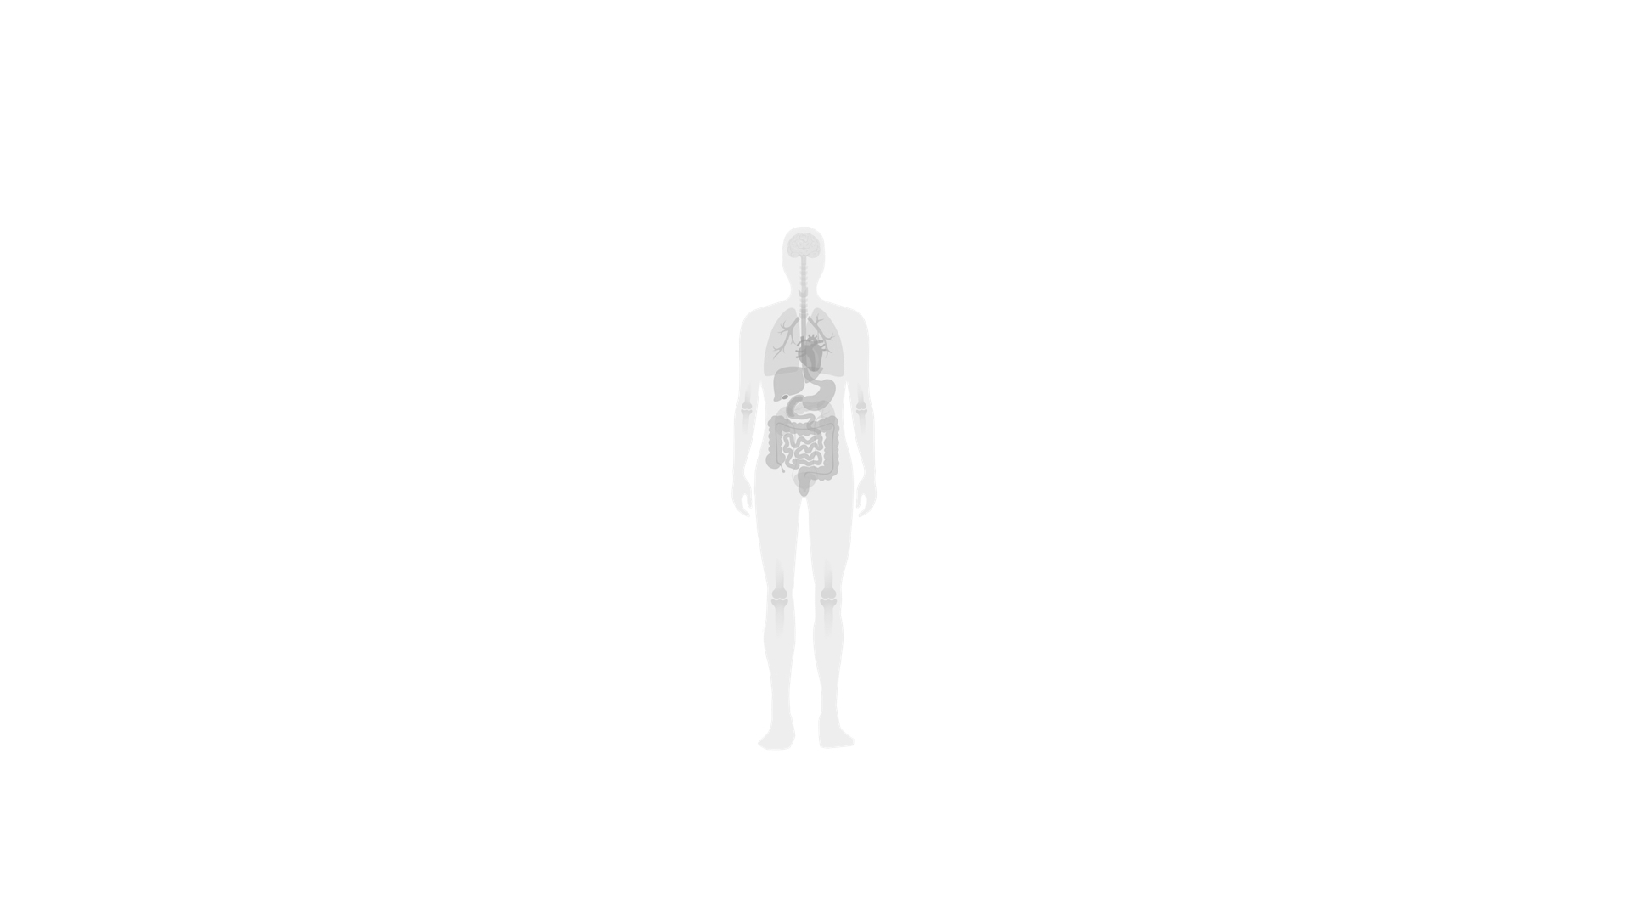
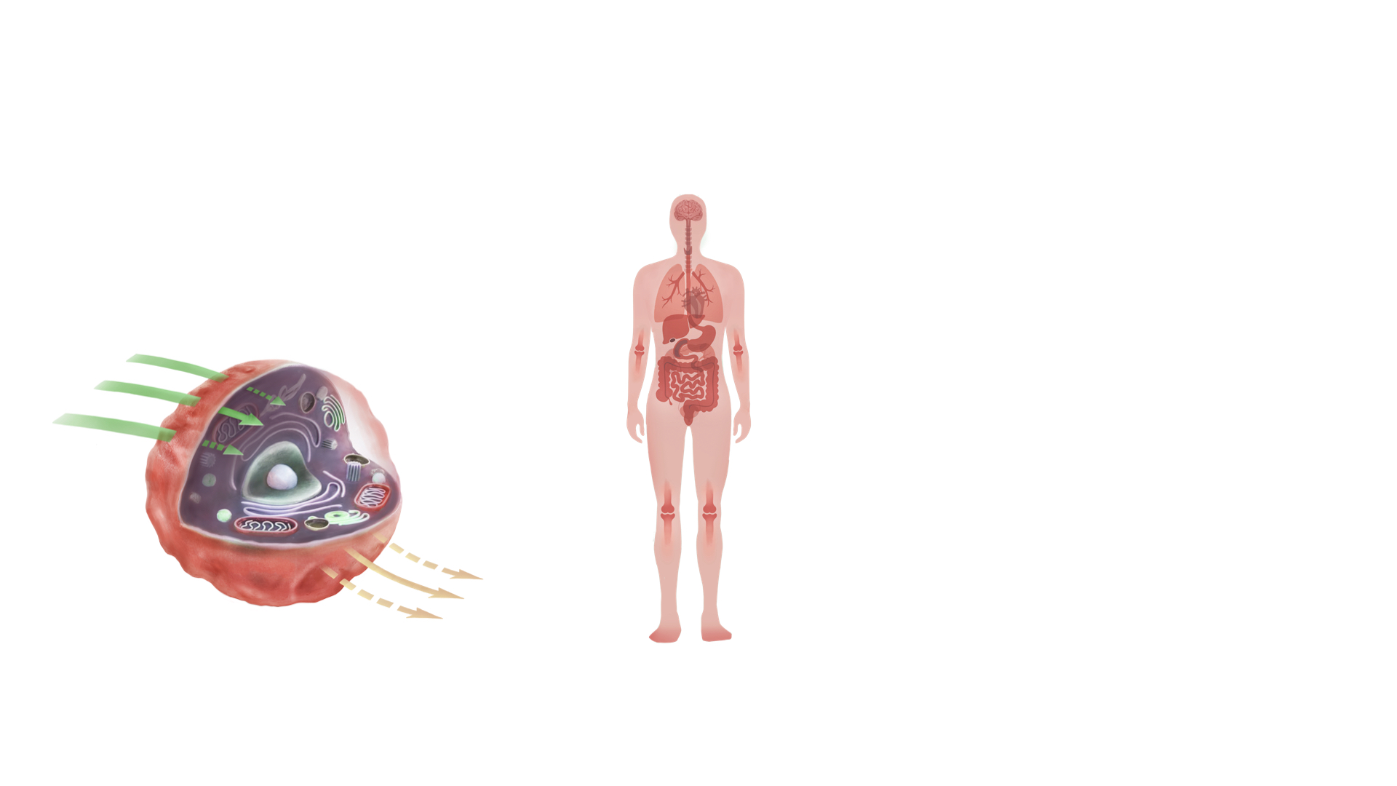
This is how it affects our cells
Brain function
Reduced function
Hair quality
Hard, rigid membrane
Heart function
Nutrients get
in slowly
Skin elasticity
Inner organs
Waste products
come out slowly
Joints and muscles
To achieve healthy cell membranes,
we need a 3:1 balance between
Omega-6 and Omega-3

Slide 8
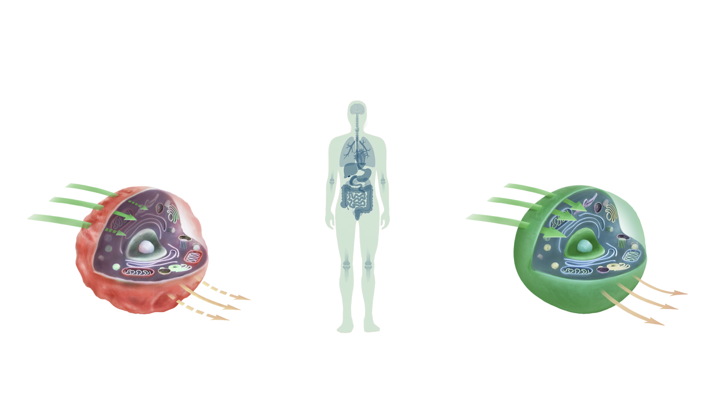
This is how it affects our cells
Brain function
Reduced function
Hair quality
normal function
Hard, rigid membrane
soft, flexible membrane
Heart function
Nutrients get
in slowly
Skin elasticity
Nutrients get
in easily
Inner organs
Waste products
come out slowly
Waste products
come out easily
Joints and muscles
To achieve healthy cell membranes,
we need a 3:1 balance between
Omega-6 and Omega-3

Slide 9
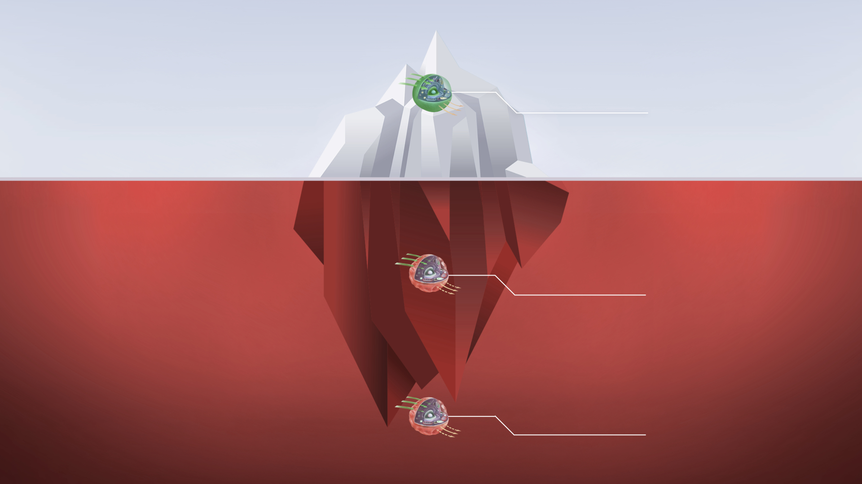
3:1
RATIO
Where you want to be
Are you in the
danger zone?
• Imbalance of Omega-6 and Omega-3
• Low levels of Omega-3
• Inadequate polyphenols in our diet
• Low levels of vitamin D3
15:1
Where you probably are
RATIO
25:1
RATIO
Where your children probably are
    REFERENCES
    • The World Health Organization
    (WHO) - 4:1 or lower.
    • Nordic Council of Ministers, Nordic Nutritional
    Recommendations 2004/2012 - 5:1 or lower.

Slide 10


Would you like to take a test
and find out your results?
Money-Back Guarantee:
Applies if you have an Omega-6:3 Balance of 3:1 or better on your first BalanceTest.
This offer is only valid if a monthly subscription was chosen.

Slide 11
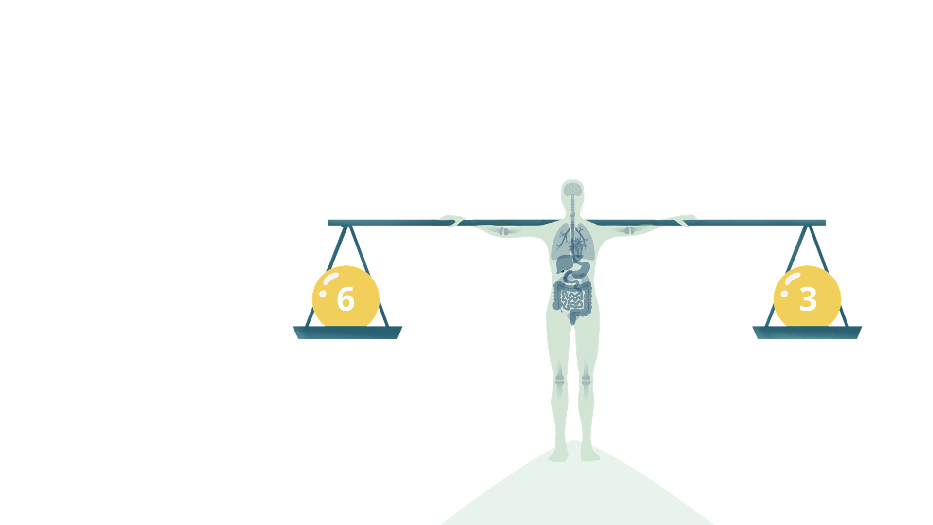
We can bring you back
into balance in 120 days
Normal brain function
Good hair quality
Heart function
Skin elasticity
Inner organs work
Joints and muscles work

Slide 12






With our unique,
test-based formula
Polyphenols
(olive)
Dosage by weight
Omega-3, EPA, DHA, DPA
(from wild fish)
No oxidation
Vitamin D3
Original
Water-soluble AquaX
Vitamin E
(tocopherols / tocotrienols)
Orange Lemon Mint
Grapefruit Lemon Lime

Slide 13

Thank you

Slide 14


